Slide 1
專題進度報告
名子 : Nawisa
日期 : 6/21/22

Slide 2
專題進度報告
負 責 人：Prof. 陳朝烈
目前成員：
開始日期：
結束日期：-

Slide 3
To Do List
To do list:
1. Compare the architecture of two algorithms ,YOLOv4 and YOLOR. 2. Find special features of YOLOv4 and YOLOR, advantages and different things.
3. Read Tutorials and research >> read paper.

Slide 4
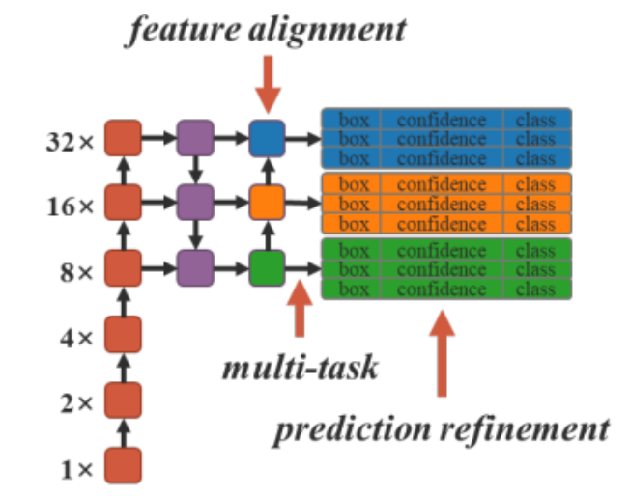
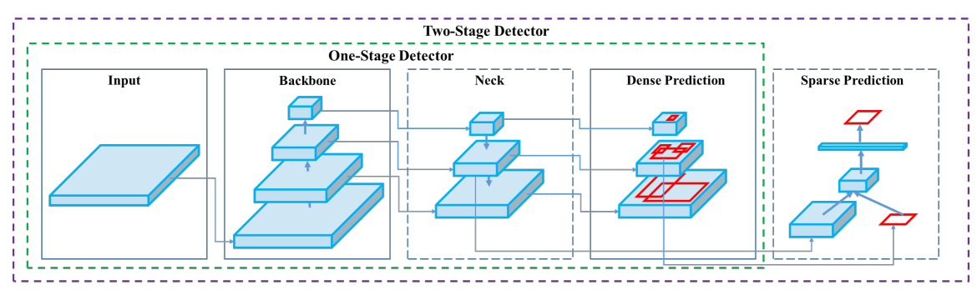
Compared Architectures
YOLOv4:
Input: {Image, patches., Image Pyramid,…}
Backbone: CSPDarknet53
Spatial pyramid pooling additional module
Neck: PANet path-aggregation
Head: YOLOv3
YOLOR:
Feature alignment
Multi tasking
Prediction refinement

Slide 5
Special features
YOLOv4:
Weighted-Residual-Connections (WRC)
Cross-Stage-Partial-Connections (CSP),
  A new backbone that can enhance learning capability of CNN
Cross mini-Batch Normalization (CmBN),
  represents a CBN modified version which assumes a batch contains four mini-batches
Self-adversarial-training (SAT),
  represents a new data augmentation technique that operates in 2 forward backward stages
Mish-activation,
  A novel self regularized non-monotonic neural activation function
Mosaic data augmentation,
  represents a new data augmentation method that mixes 4 training images instead of a single image
DropBlock regularization, a better regularization method for CNN
CIoU loss,
  achieves better convergence speed and accuracy on the BBox regression problem
YOLOR:
Explicit knowledge – the knowledge receives from observation such as, to see, to hear, etc.
Implicit knowledge – the knowledge receives from experiment, from learning.
- To serve many tasks given one input, train to solve multiple problems at once.
- To have CNNs both to learn how to get outputs and what all the different outputs could be. Rather than just one output, it can have many.
- Combination of implicit and explicit makes the improving in speed.
Notes:
Yolor adopts any model in yolov4? Do they have common component or not?
What is the most important progress which improve from the previous version?
What are the problems of R?
Concept points? To make comparison

Slide 6

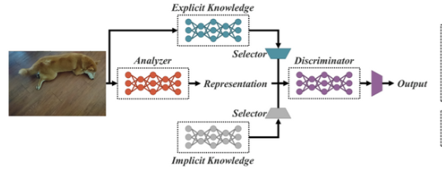
Questions and Answers
Question: YoloR adopts any model in yolov4? Do they have common component or not?
  Training model through backpropagation algorithm as any other models.
Question: What is the most important progress which improve from the previous version?
  This version includes unified network, they used explicit and implicit knowledges as special features.
Question: What are the problems of R?
  The parameters of transformer model are often billions or even ten of billions.
  It requires huge computing resources to train a pre-trained models.
  Therefore, it is a technology that can only be financially developed by large enterprises.
  The pre-training models of these large companies might have copyright concerns on the training materials they used, so they have to spend money to train the models.
Question: Concept points? To make comparison
  YoloR is different from other version of Yolo because it uses a unified network to encode implicit knowledge and explicit knowledge at the same time.
  YoloR can perform Kernel space alignment, prediction refinement, multi-task learning in a CNN.
The unified model
Notes:
What the purpose of each boxes. (need to have the purpose first),(* purpose of analyzer -> representation).
Can we make replace some of this box with some image processing techniques? To have more efficient ways.

Slide 7
Next
What the purpose of each boxes. (need to have the purpose first),(* purpose of analyzer -> representation).
Can we replace some of this box with some image processing techniques? To have more efficient ways.

